Slide 1
STA/BST 222 Survival Analysis Lecture 4
Lihong Qi
Division of Biostatistics
Department of Public Health Sciences
School of Medicine
Oct. 13, 2020

Slide 2
How to contact me
Email is best: lhqi@ucdavis.edu
Phone: 530-754-9234
Office hour: email for an appointment

Slide 3
How to contact TA
Xiner Zhou
Email: xezhou@ucdavis.edu
Office hours: 7:00pm – 8:00pm, Thursdays
Lab: 6:10-7:00 pm, Thursdays
For both Lab and OH, please use the zoom link with passcode: survival https://ucdstats.zoom.us/j/9681353237?pwd=ZzhLRHlhNG92bHFUaHkwM0Fib1pqQT09 Meeting ID: 968 135 3237

Slide 4
Outline
Introduction
Methods for describing survival data
Summary, exercise
Homework
Lab

Slide 5
How to describe survival data?

Slide 6
Examples of the questions of interest
In survival analysis:
What is the probability that a participant survives 5 years?
Are there differences in survival between groups (e.g., between those assigned to a new versus a standard drug in a clinical trial)?
How do certain personal, behavioral or clinical characteristics affect participants' chances of survival?

Slide 7
How to describe survival data?
T (t, specific value for T): a nonnegative random variable representing the time until some event of interest. E.g.
the time from diagnosis of a disease until death,
the time between administration of a vaccine and development of an infection,
the time from the start of treatment of a symptomatic disease and the suppression of symptoms.
Assume T is continuous unless specified otherwise
Event indicator: I(d=1)

Slide 8
How to describe survival data?
Survival function S(t)
Hazard function (rate) h(t): instant risk
Cumulative hazard function H(t)
Mean survival time
Median survival time

Slide 9
Survival function
Survival function S(t): the probability that the event of interest has not yet occurred by time t
If T denote time to death, S(t) is the chance of surviving longer than t.
When T is continuous, S(t) is continuous in t
Also known as survivor or survivorship function, or reliability function (in the context of equipment or manufactured item failures).
Denoted as S(t)=Pr(T>t).
S(0)=?
S(∞)=?

Slide 10
Survival Function
Non-increasing function of time.
S(t1) ≤ S(t2) if t1 ? t2
0≤ S(t) ≤ 1
An example

Slide 11
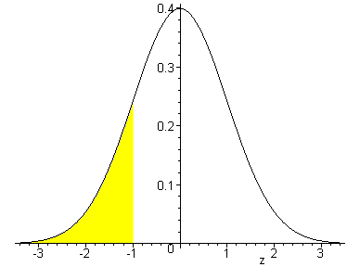
S(t)=1-F(t)
Probability density function (pdf)
Lognormal distribution, i.e. log(T)~normal distribution
F(t) = Pr(T <= t)
S(t)
F(t)
Log(T)

Slide 12
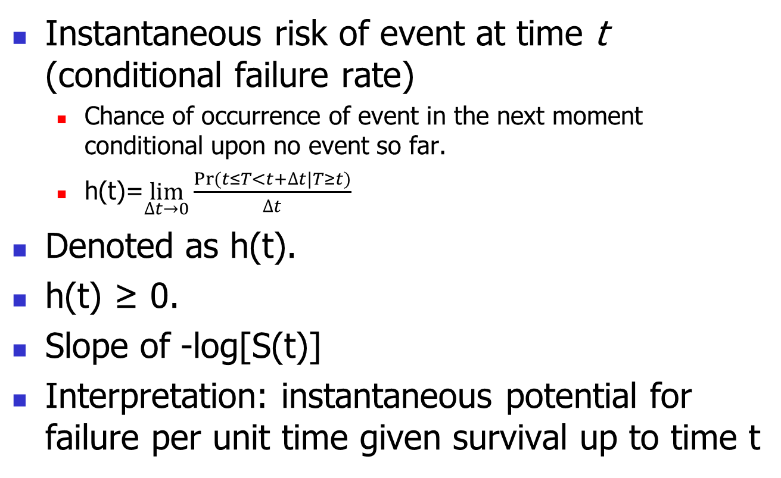
Hazard Function
Instantaneous risk of event at time t (conditional failure rate)
Chance of occurrence of event in the next moment conditional upon no event so far.
h(t)=$\lim_{∆t→0}{\frac{Pr⁡(t≤T<t+∆t|T≥t)}{∆t}}$
Denoted as h(t).
h(t) ≥ 0.
Slope of -log[S(t)]
Interpretation: instantaneous potential for failure per unit time given survival up to time t

Slide 13
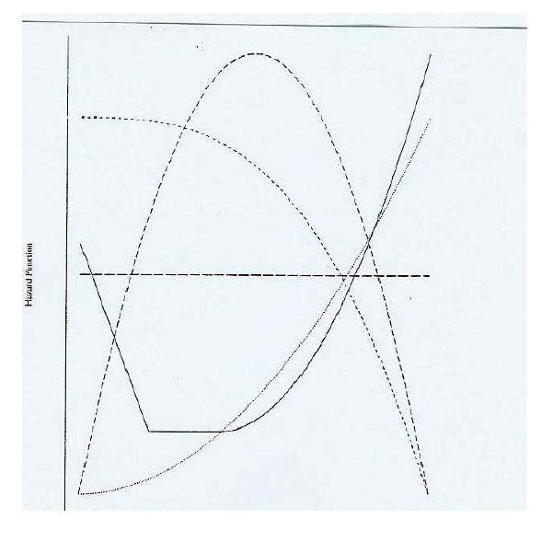
Shapes of generic hazard function
Constant: exponential
Decreasing: less common; a business that has lasted two centuries is less likely to go bankrupt than one that has lasted two years.
Increasing: describes things more likely to fail with time. Eg natural aging or parts wear
Bathtub: describes things that have relatively high failure rates when very young or very old, but flat rates in middle age (such as human beings and some machines). E.g. most population mortality data
Quadratic. Eg. recovery after surgery

Slide 14
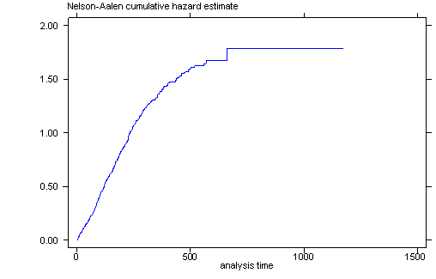

Cumulative Hazard Function
Cumulative risk up to time t.
Denoted by H(t)=$\int_{0}^{t}{h\left(u\right)du}$.
H(t)≥0.
Non-decreasing function. Why?

Slide 15
Relationship between survivor and hazard functions
Hazard function is the derivative of the -log survivor function over time, i.e. h(t)=-d[ln(S(t))/dt], slope of -log[S(t)]
Survivor and hazard functions can be converted into each other
h(t)=f(t)/S(t), where f(t) is the pdf of failure time.
H(t)=-ln[S(t)]
h(t)=dH(t)/dt

Slide 16
Common parametric distributions

Slide 17
Exponential distribution
f(t)= ?
λe^{−λt}
S(t)= ?
e^{−λt}
h(t)=?
λ , Constant hazard
H(t)=?
λt
Memoryless/Lack of Memory property:
P[T > t] = P[T > t + t0|T > t0] for any t0 > 0 (probability of surviving another t time units does not depend on how long the subject has lived so far)

Slide 18
Weibull distribution
f(t)=
S(t)=?
h(t)=?
H(t)=?
A generalization of the exponential distribution.

Slide 19
Weibull distribution
Flexible hazard functions
h(t)=
p >1, increasing
p < 1, decreasing
p = 1, constant: exponential
Popular in reliability
engineering and lifetime
data analysis

Slide 20
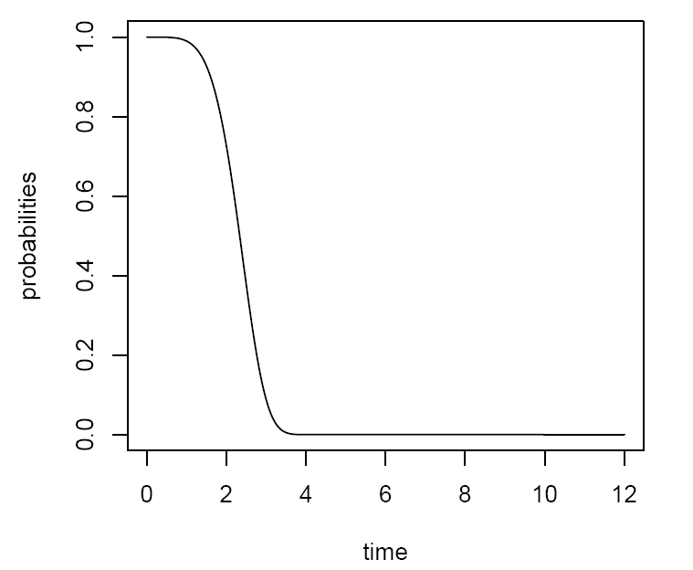
Mean survival time
Mean survival time (on the average how long survival time is)
Area under the survival curve.
The estimator is based upon the
entire range of data.

Slide 21
Mean residual life time
Mean residual life time, mrl(t₀) = E(T-t₀| T>t₀ ), measures expected remaining lifetime (on the average how much longer will survive given being surviving time t₀)
Conditional mean survival time.
Area under the curve to the right of t divided by S(t₀).
(read KM theoretical notes in Section 2.4 for proof)

Slide 22

Median survival time t_{0.50}
Time at which survival function is equal to 0.50.
t_{0.50}: Minimum t satisfies F(t_{0.50})≥0.50 and S(t_{0.50})≤0.50
the smallest survival time for which the survivor function is less than or equal to 0.5
The median for survival function is usually not the same as the time up to which 50% of the sample survived (due to censored observations prior to this time.)

Slide 23
Mean Vs. Median Survival Time
Which one is more robust to potential outliers?
Samples of survival times are frequently highly skewed, therefore, in survival analysis, the median is generally a better measure of central location than the mean.

Slide 24
Regression Analysis
Log transformation on time, log(T).
Could use a linear regression model for log(T), called accelerated failure-time (AFT) model
Different error distributions result in different models. E.g.
Normal: log normal
Extreme value distribution: Weibull regression model
Needs special care for censored observations.
Buckley James estimator, extension of the least squares estimator

Slide 25
Summary
Methods for describing survival data:
Survival function: chance of surviving longer than t
Hazard function: instant risk
Cumulative hazard function
h(t)=f(t)/S(t)
H(t)=-ln[S(t)]
h(t)=dH(t)/dt
Distributions of event time

Slide 26
Exercises
T denotes the age of a car when it first has a serious engine problem. What would you expect the corresponding hazard function h(t) to be?
Increasing in t
Decreasing in t
Constant
If one were studying infant mortality in a region of the world where there was poor nutrition, what would you expect h(t) to be during the first year of life?
Increasing in t
Decreasing in t
Constant
Time (beginning now) until an earthquake occurs. What would you expect h(t) to be e? What distribution can you use to describe the lifetime?
Increasing in t
Decreasing in t
Constant

Slide 27
Homework 2
1. Reading the textbook KM, Chapter 2.1 – 2.6, 3.5
2. Answer the following questions:
What are the new things you’ve learned, or new understanding of something you knew before?
How would you apply them to your research/project?
3. Will be given separately via Canvas

